Slide 1
FACEBOOK Developer Seminar
Create your own Facebook Bot.

Slide 2
Whoami ?
Sumair Baloch
C.O.O. Codex Solutions
M.D. Cic Hub
JavaScript avid developer

Slide 3
Facebook Bot
Facebook Developers Group

Slide 4
Tools?
Node.js
Heroku toolbelt.
Git

Slide 5
Index.js
https://cicbot.herokuapp.com/index.js

Slide 6
Lets Build One

Slide 7
Facebook recently opened up their Messenger platform to enable bots to converse with users through Facebook Apps and on Facebook Pages. This is a simpler version of jw84's bot tutorial.
You can read the documentation the Messenger team prepared but it's not very clear for beginners and intermediate hackers.
So instead here is how to create your own messenger bot in 15 minutes.

Slide 8
Get Set
Messenger bots uses a web server to process messages it receives or to figure out what messages to send. You also need to have the bot be authenticated to speak with the web server and the bot approved by Facebook to speak with the public.

Slide 9
Build the server
You need a publicly accessible server URL. Heroku is a good free place. Install the Heroku toolbelt from here https://toolbelt.heroku.com to launch, stop and monitor instances. Sign up for free at https://www.heroku.com if you don't have an account yet.
Install Node from here https://nodejs.org, this will be the server environment.
Create a new folder somewhere and let's create a new Node project. Hit Enter to accept the defaults.
Install the additional Node dependencies. Express is for the server, request is for sending out messages and body-parser is to process messages.
npm init
npm install express request body-parser --save

Slide 10
Build the server
Create an index.js file in the folder and copy this into it. We will start by authenticating the bot. (Files attached)
Make a file called “Procfile” and copy this. This is so Heroku can know what file to run.
Commit all code with Git then create a new Heroku instance and push the code to the cloud.
web: node index.js
git init
git add .
git commit --message ‘hello world’
heroku create
git push heroku master

Slide 11
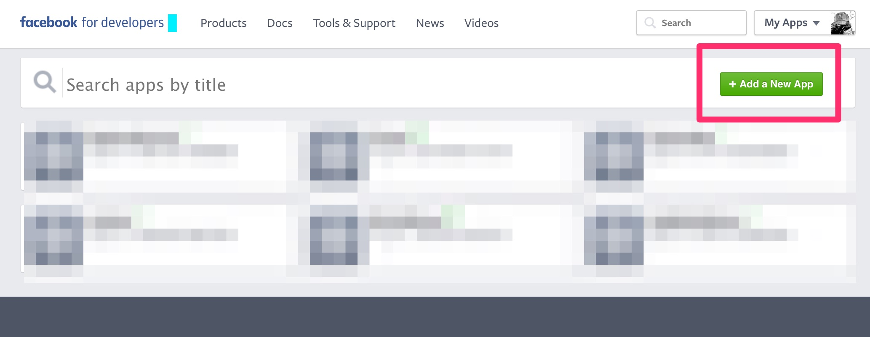
Setup Facebook App
Create of configure Facebook App or Page here: https://developers.facebook.com

Slide 12
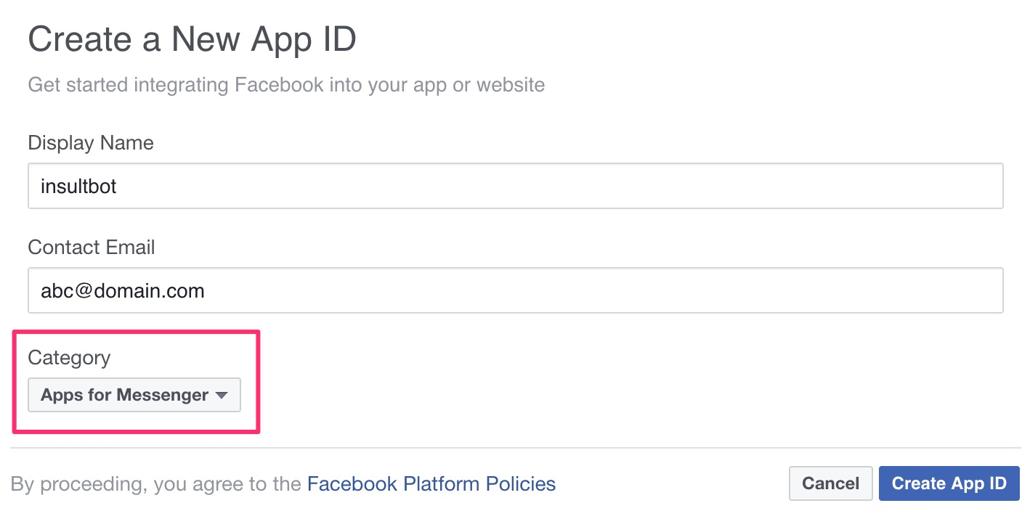
Setup Facebook App
Create of configure Facebook App or Page here: https://developers.facebook.com

Slide 13
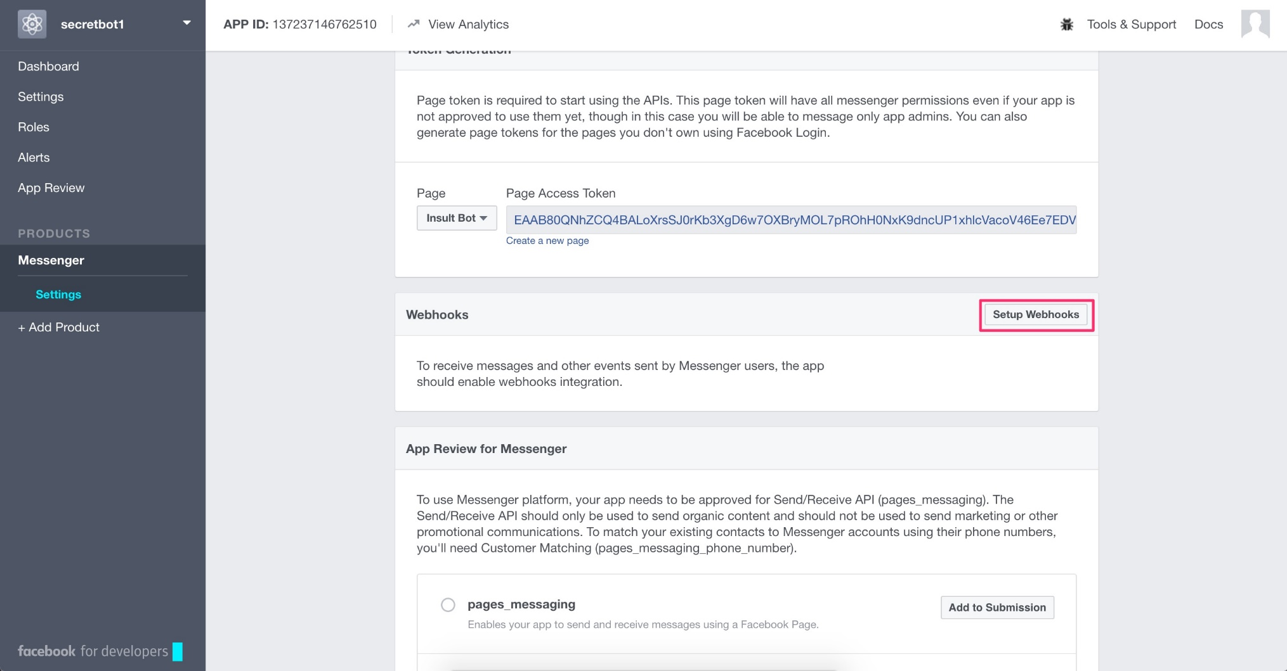
Setup Facebook App
In the app go to Messenger tab then click Setup Webhook. Here you will put in the URL of your Heroku server and a token. Make sure to check all the subscription fields.

Slide 14
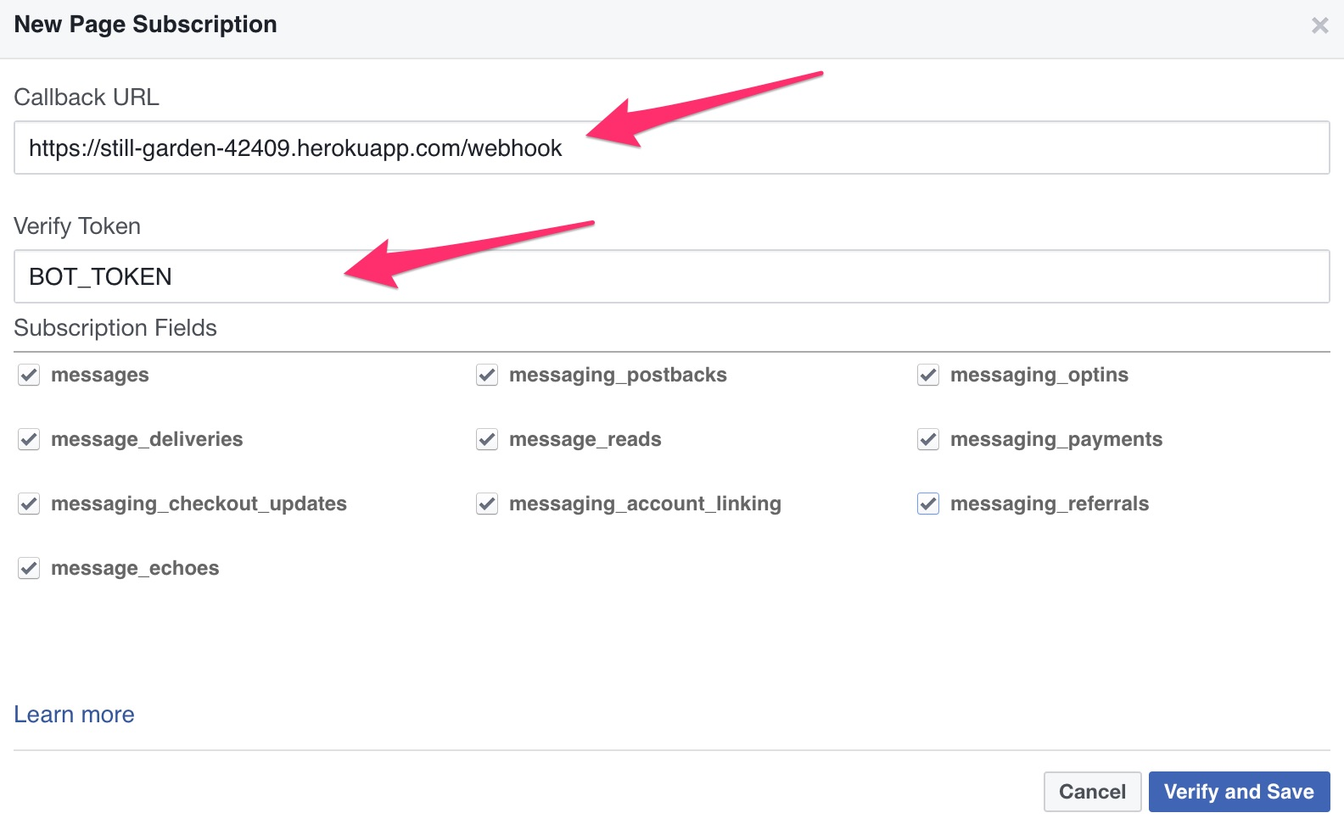
Setup Facebook App
In the app go to Messenger tab then click Setup Webhook. Here you will put in the URL of your Heroku server and a token. Make sure to check all the subscription fields.

Slide 15
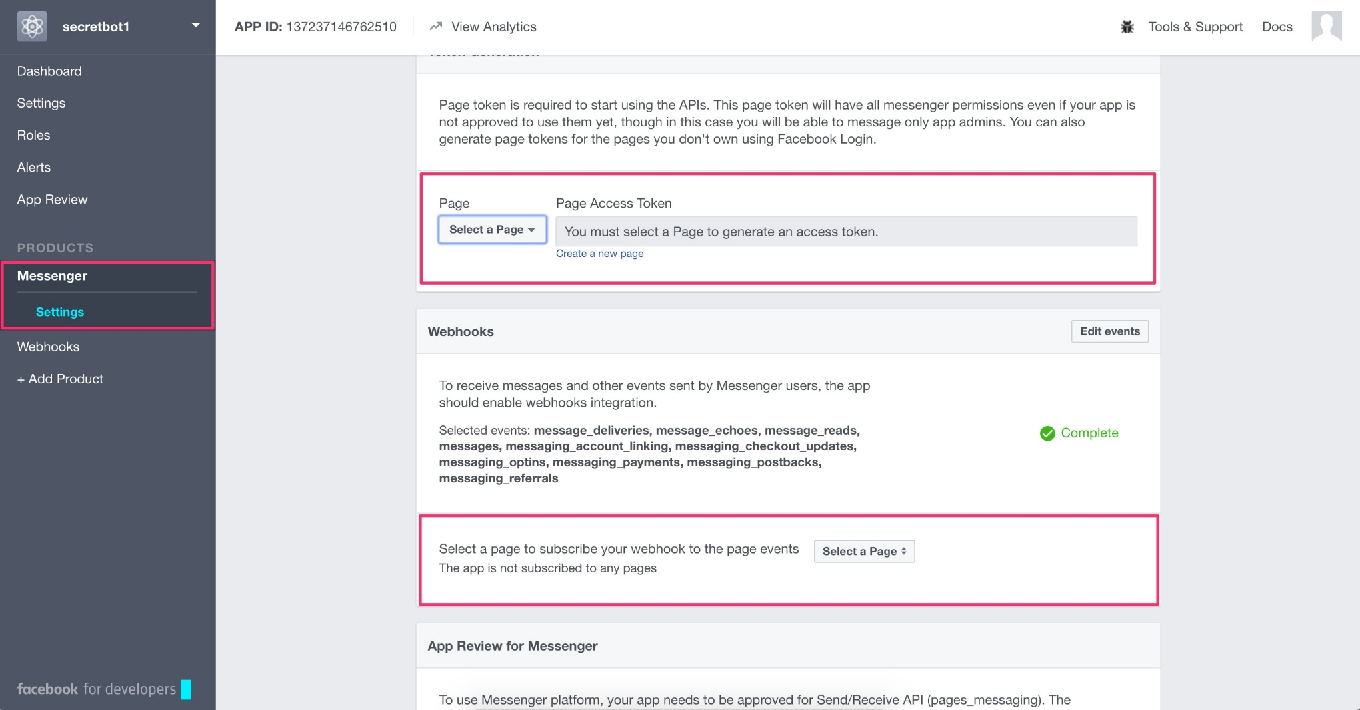
Setup Facebook App
You need a new Facebook page for your bot (or can use an existing one). Get a Page Access Token and save this somewhere. Also subscribe the webhook for your page.

Slide 16
Setup Facebook App
Go back to Terminal and type in this command to trigger the Facebbook app to send messages. Remember to use the token you requested earlier. This should return a JSON success.
Update your TOKEN in the code at line no. 42.
Commit the code again and push to Heroku.
curl –X POST “https://graph.facebook.com/v2.6/me/subscribed_apps?access_token=PAGE_TOKEN
git add .
git commit --message ‘hello world’
git push heroku master

Slide 17
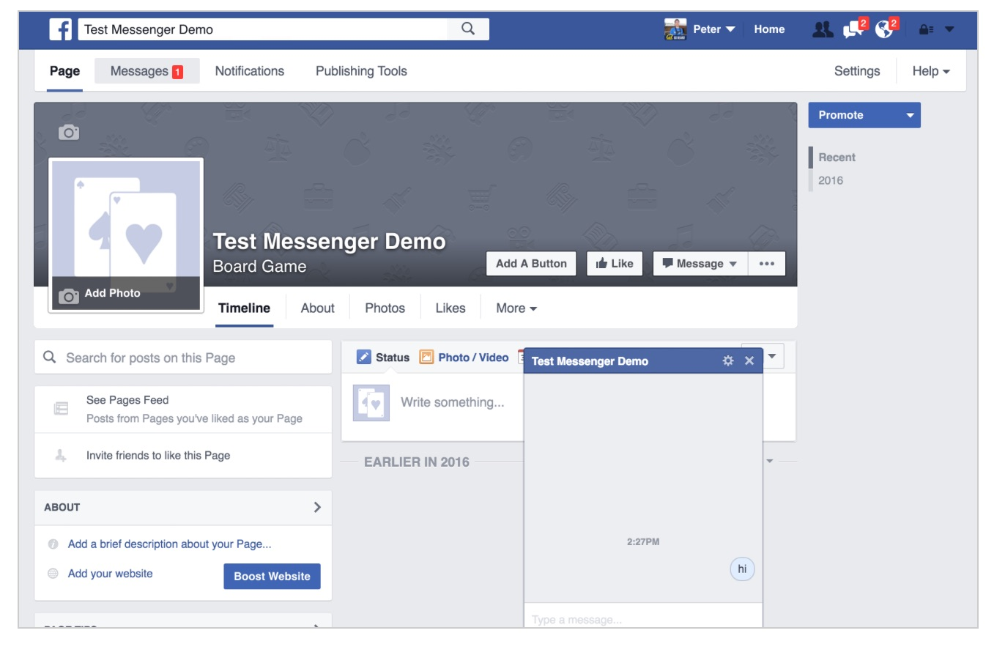
Play with your bot
Go to your Facebook page and click on Message to start chatting.

Slide 18
Codex Student Partners
Learn, share and Create

Slide 19
Internship Opportunities
Incubation, Entrepreneurship

Slide 20
Questions?
All questions are answered here,
Even the stupid ones.

